Slide 1
RAG-based Enhancements for Context-Aware Interfaces in Large Language Model
Thesis Defense Presentation
Siri Priya Katta
Southern Illinois University, Carbondale
Computer Science
Advisor : Dr.Henry Hexmoor
Members of Committee :
Dr.Bidyut Guptha
Dr.Koushik Sinha

Slide 2
Agenda
Introduction
Problem Statement
Why this Challenge Matters
Literature Survey
Comparative Insights & Identified Gaps
Proposed Framework & Work Done
State-of-the-Art: Graph RAG & Advanced Reasoning
Results & Key Findings
Conclusion

Slide 3
Introduction
Large Language Models (LLMs) have achieved remarkable success in understanding and generating human-like text.
However, they often hallucinate or produce factually incorrect answers when relying only on internal training data.
Retrieval-Augmented Generation (RAG) addresses this limitation by allowing LLMs to retrieve external knowledge during response generation.
This thesis explores how RAG frameworks and their extensions can enhance factuality and reasoning in LLMs through better context handling and retrieval integration.
The study includes a comparative analysis of existing RAG architectures and the emerging Graph RAG approaches to establish a clearer understanding of their impact on context-aware reasoning.

Slide 4
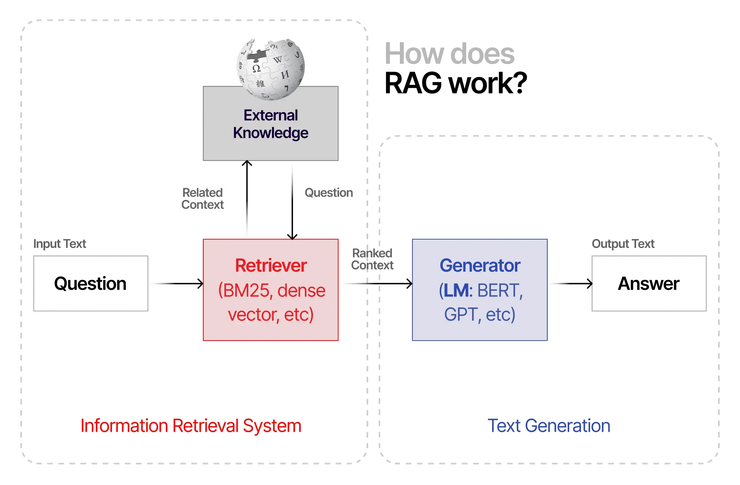
RAG Architecture: At a Glance
Retrieval-Augmented Generation (RAG) pipelines consist of two key stages — a retriever that fetches relevant documents from external sources and a generator that synthesizes this information to produce more accurate and context-aware responses.

Slide 5
Problem Statement
LLMs face challenges in providing accurate and contextually grounded responses in real-world tasks.
RAG offers a promising solution by integrating retrieval mechanisms to fetch relevant external documents in real-time.
However, existing RAG models still face:
- Inefficient retrievals
- Poor integration of retrieved content into generation
- Limited reasoning enhancement
This thesis addresses these gaps through a comparative study of RAG architectures and an empirical two-stage retrieval experiment, aimed at improving RAG integration and analyzing its impact on retrieval accuracy.

Slide 6
Why This Challenge Matters
Without RAG
Static knowledge → hallucinations
Shallow context
Low trust in outputs
With RAG / Graph RAG
Dynamic retrieval → factual accuracy
Rich multi-hop reasoning (Graph)
Reliable context-aware responses
Without strong context integration, LLMs continue to hallucinate and provide inconsistent answers.
Many domains — healthcare, finance, education — require accurate, interpretable, and up-to-date responses.
RAG architectures improve factuality by connecting LLMs to external knowledge, but their reasoning ability is still limited.
Enhancing retrieval + generation fusion directly improves trust, reliability, and real-world deployment of LLMs.
The rise of Graph RAG highlights the next step — reasoning through structured, relational knowledge instead of unlinked text.

Slide 7
Literature Survey

Slide 8
Paper | Main Contribution / Focus | Methodology / Approach | Key Limitation
Lewis et al., 2020 Retrieval-Augmented Generation (RAG) | Lewis et al., 2020 Retrieval-Augmented Generation (RAG) | Dense Passage Retriever (DPR) + BART generator jointly trained to retrieve and generate grounded | Limited reasoning; shallow context fusion; treats all retrieved docs equally without deeper understanding.
Izacard & Grave, 2022 Fusion-in-Decoder (FiD) | Enhanced RAG by improving how multiple documents are integrated for reasoning. | Each retrieved passage encoded separately, and fusion happens in the decoder through multi-document attention | Computationally expensive; limited scalability; reasoning still implicit.
Khattab & Zaharia, 2020 ColBERT (Late Interaction Retrieval) | Improved retrieval efficiency and precision through token-level contextual matching | Late interaction between query and document embeddings; lightweight scoring using compressed representations. | Focused only on retrieval; lacks reasoning or integration with generation.

Slide 9
Paper / Work | Main Contribution | Methodology / Approach | Key Limitation
Shuster et al., 2023 Faithful Chain-of-Thought Reasoning via Retrieval-Augmentation | Combined factual retrieval with transparent, step-by-step reasoning to improve reasoning faithfulness. | Integrates chain-of-thought prompting with retrieval at each reasoning step to ground intermediate reasoning. | High computation; no explicit structural reasoning; reasoning still text-based.
Zhu et al., 2024 GraphRAG for Knowledge-Intensive Reasoning | Introduced graph-based retrieval — representing knowledge as entities and relationships for structured reasoning. | Builds knowledge graphs, retrieves subgraphs (nodes + neighbors), converts to text/embeddings for LLM input. | Requires knowledge graph construction; domain-limited; structure-to-text conversion loses some information.
Hu et al., 2024 Enhanced GraphRAG (Microsoft Research) | Integrated graph-structured and text-based retrieval for hybrid reasoning and factual grounding. | Two-stage retrieval (graph + text), graph embeddings fused with LLM attention for structural reasoning. | Heavy preprocessing; complex integration; limited generalization to open-domain tasks.

Slide 10
Recent Advances in Retrieval-Augmented Generation (2025)
Paper: Sharma, C. (2025) Retrieval-Augmented Generation: A Comprehensive Survey of Architectures, Enhancements, and Robustness Frontiers (arXiv)
Main Contribution:
Presents a comprehensive taxonomy of RAG architectures covering retrieval strategies, fusion mechanisms, and reasoning-aware enhancements
Identifies key limitations in existing RAG systems, including shallow context fusion, redundant retrievals, and limited multi-hop reasoning
Consolidates state-of-the-art RAG developments up to 2025
Limitations:
No empirical evaluation or unified benchmarking
Does not propose an integrated end-to-end RAG framework
Limited discussion of scalability and deployment constraints

Slide 11
Comparative Insights & Identified Gaps
Early RAG models (Lewis et al., FiD, ColBERT) improved factual accuracy but relied on linear document fusion and offered limited reasoning.
FiD enhanced multi-document understanding through decoder-level fusion, but reasoning remained implicit.
CoT-RAG introduced retrieval-augmented step-by-step reasoning, improving transparency and factual grounding.
GraphRAG and Enhanced GraphRAG incorporated structured retrieval using knowledge graphs, enabling multi-hop and relational reasoning.
Recent works highlight a trend from retrieval-focused to reasoning-aware and graph-integrated systems.

Slide 12
Proposed Framework & Work Done
Formulated a Two-Stage Retrieval Pipeline combining dense passage retrieval with CrossEncoder reranking for improved context selection.
Dataset & Setup: Evaluated on the CoQA conversational question-answering dataset with 437 context paragraphs and 100 benchmark questions.
Dense Retrieval Stage: Generated embeddings using MiniLM-L6-v2 to compute semantic similarity between queries and passages.
Reranking Stage: Applied a pre-trained CrossEncoder model to re-rank the top retrieved passages and select the most relevant context.
Evaluation Metrics: Compared baseline (dense retrieval only) vs. two-stage (dense + reranking) using Hit@1 and EM@1 scores.
Key Implementation: Implemented end-to-end pipeline with efficient candidate retrieval followed by cross-attention reranking for refined passage selection.

Slide 13
Baseline vs Two-Stage Architecture
Baseline Retrieval (Dense Similarity Search)
Uses MiniLM embeddings to compute cosine similarity
Selects Top-1 most similar passage for each question
Retrieval is single-pass, shallow, and purely similarity-based
Fast but lacks cross-attention filtering
Two-Stage Retrieval (Dense + Reranking)
Dense stage: retrieves Top-5 candidate passages using MiniLM
Reranking stage: applies CrossEncoder to score and select Top-1 best match
Uses cross-attention mechanism for refined passage selection
Slower but significantly more accurate context matching

Slide 14
Scientific Contributions
Systematic evaluation of retrieval quality in RAG pipelines using a controlled two-stage retrieval framework (dense retriever + cross-encoder reranker) on the CoQA conversational QA dataset.
Empirical evidence that reranking significantly improves top-1 retrieval accuracy, demonstrating measurable gains in Hit@1 and EM@1 without retraining any models.
Component-level analysis of retrieval vs. generation, showing that retrieval quality dominates downstream answer correctness when generation context is fixed.
Comparative positioning of practical RAG systems, connecting experimental findings to real-world architectures such as NotebookLM and emerging Graph RAG systems.

Slide 15
Experimental Setup and Data
Dataset
CoQA (Conversational Question Answering) dataset
Contains multi-turn questions grounded in narrative passages
Evaluation subset: 437 unique context passages and 100 benchmark questions, manually verified
Models (Pretrained, No Fine-Tuning)
Dense Retriever: all-MiniLM-L6-v2 (bi-encoder)
Reranker: cross-encoder/ms-marco-MiniLM-L-6-v2
Evaluation Protocol
Baseline: Dense retrieval (Top-1 by cosine similarity)
Two-stage: Dense retrieval (Top-5) + CrossEncoder reranking (Top-1)
Result Collection
Same queries, same dataset, same metrics. Only retrieval strategy varied to ensure controlled comparison

Slide 16
Evaluation Methodology
Robustness & Validation:
Bootstrap resampling: 30 iterations with replacement over 100 questions
Extended metrics: Precision, Recall, F1 score computed alongside Hit@1/EM@1
Ensures results are stable and not dependent on specific question splits
Metrics Used:
Hit@1: Does the top-1 retrieved passage contain the correct answer span?
EM@1 (Exact Match): Is the retrieved passage the exact match for the gold standard answer?
Evaluation Setup:
Benchmark: 100 representative CoQA questions across diverse topics
Query types: factual, reasoning, multi-hop understanding
Ground truth: manually verified passages containing correct answers
Comparison:
Baseline: Dense retrieval only (MiniLM Top-1)
Reranked: Dense retrieval + CrossEncoder reranking (Top-1 after reranking)

Slide 17
Results Summary Table
Metric | Baseline | Two-stage Reranked | Relative gain
Hit@1 | 0.270 | 0.360 | +33%
EM@1 | 0.250 | 0.310 | +24%
Precision | 1.000 | 1.000
Recall | 0.270 | 0.360 | +33%
F1 Score | 0.425 | 0.529 | +25%
Key Findings:
Two-stage reranking improves Hit@1 by 9 percentage points (27% → 36%)
Exact match accuracy increases by 6 percentage points (25% → 31%)
CrossEncoder reranking effectively filters noisy dense retrieval candidates
Evaluation Robustness:
Results validated through bootstrap resampling (30 iterations with replacement)
to ensure stable and generalizable performance across different question subsets.

Slide 18
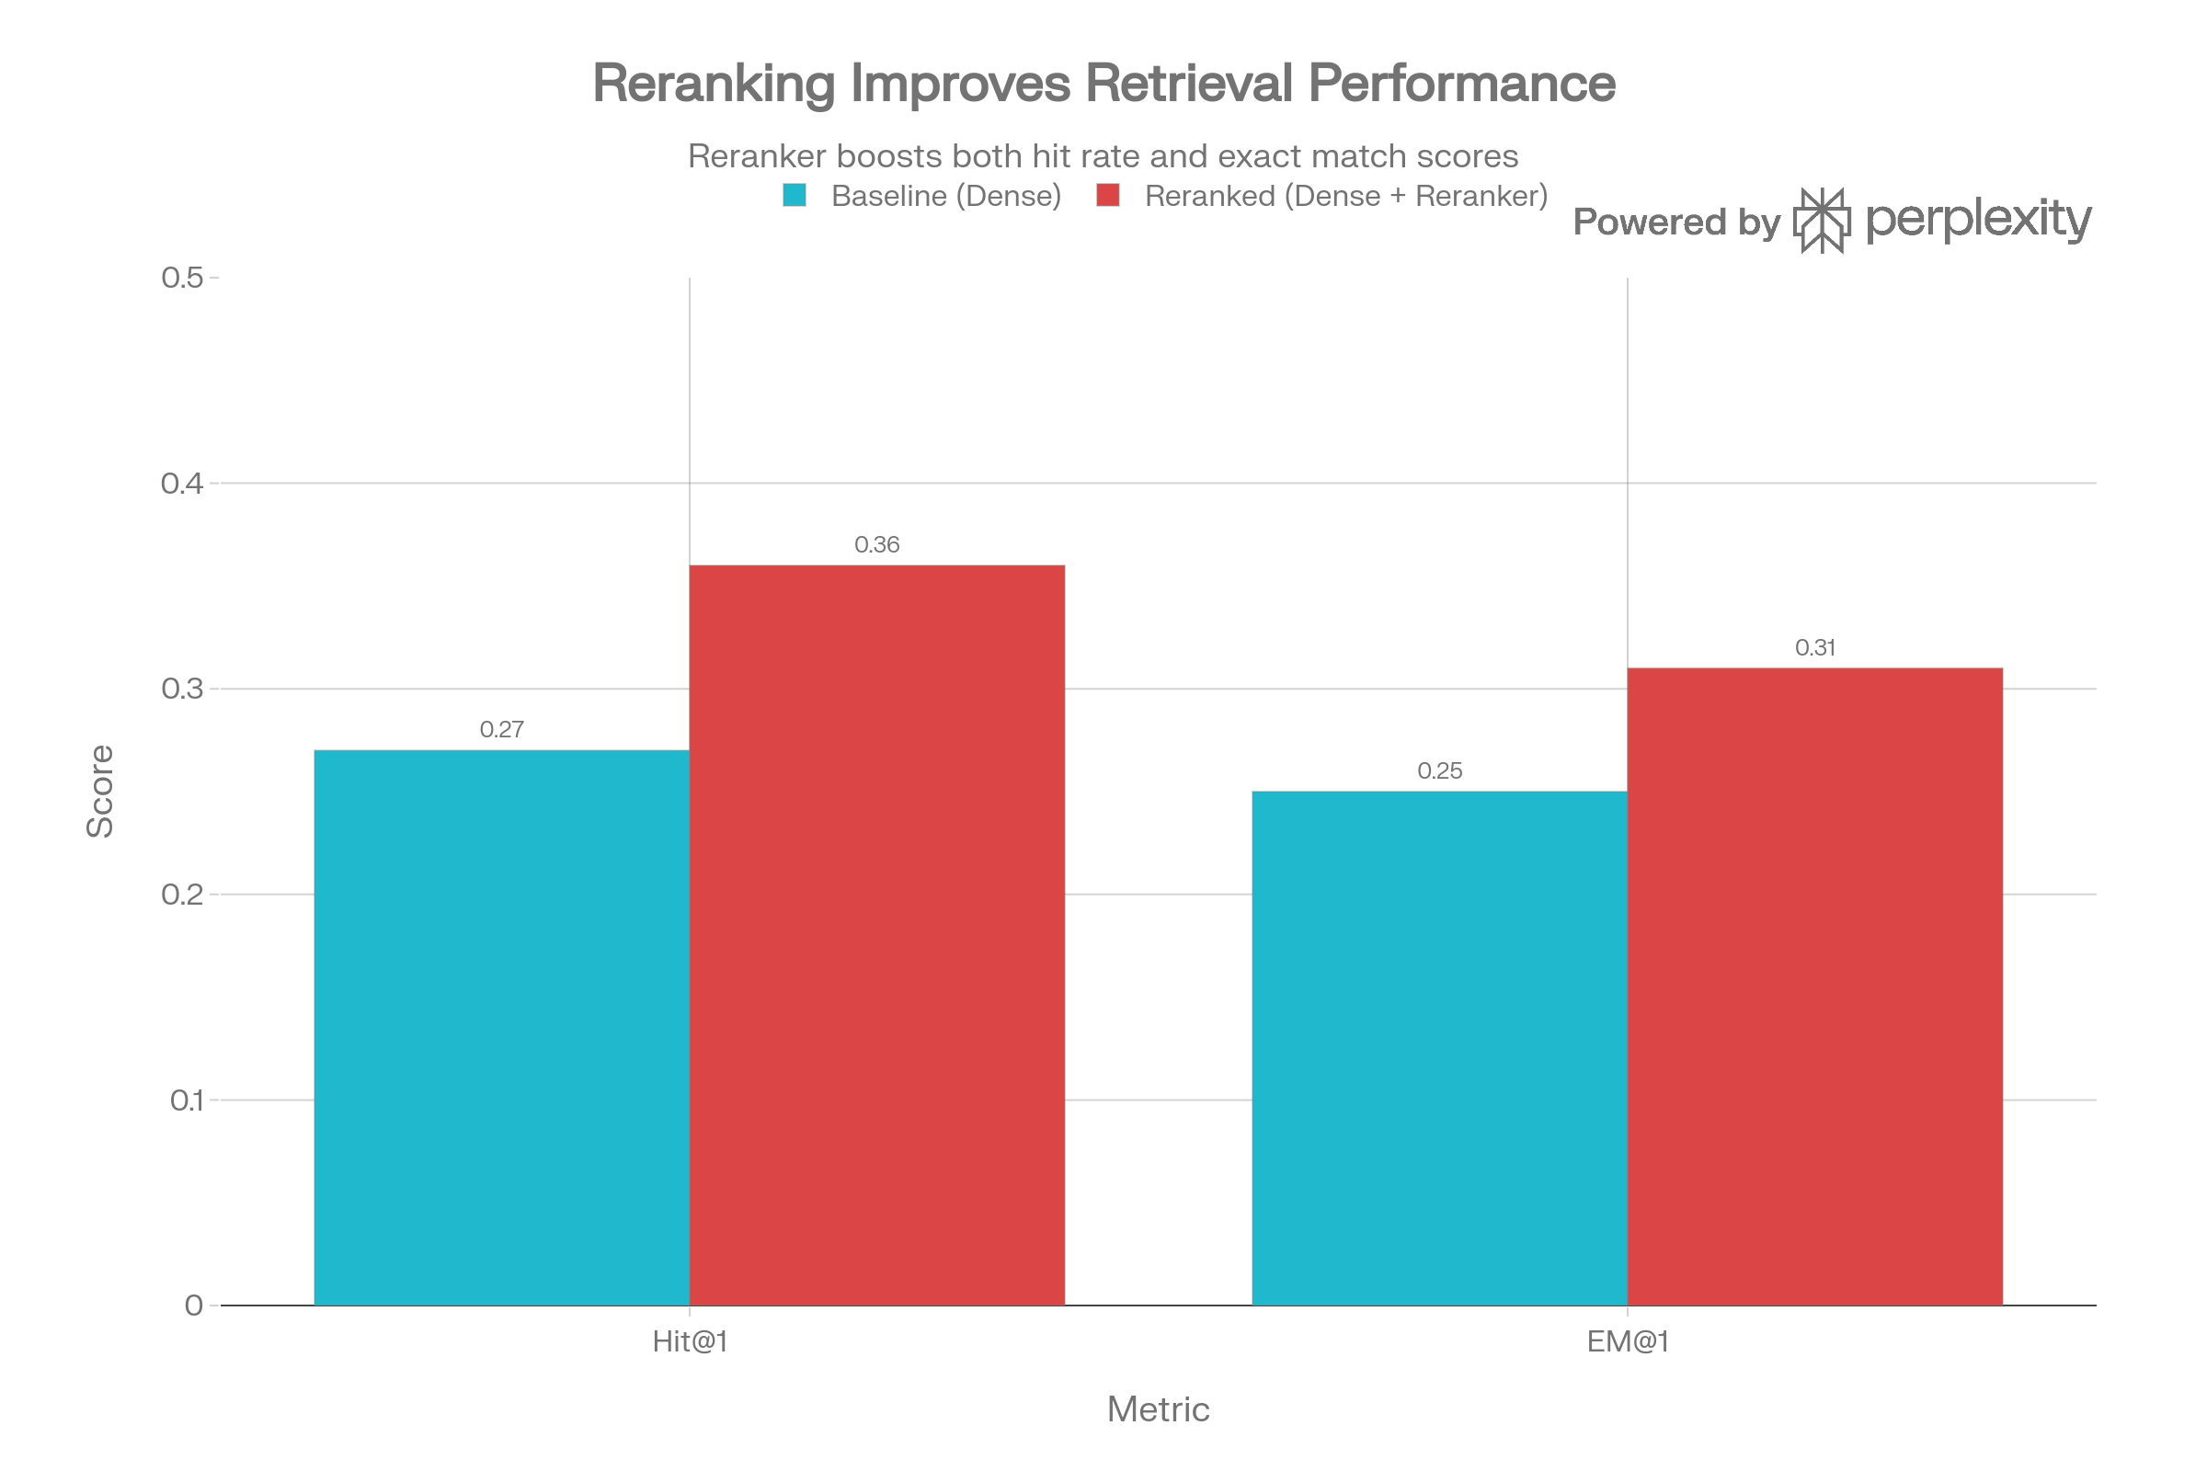
Quantitative Visualization
Hit@1 Improvement: 33% relative gain shows reranking significantly improves top-1 passage selection
EM@1 Improvement: 24% relative gain confirms better grounding in exact answer spans
Consistency: Both metrics improve, indicating stable and robust reranking performance.
Practical Impact: For every 10 questions, baseline correctly retrieves ~3, reranked retrieves ~4 — a measurable boost in retrieval accuracy

Slide 19
State-of-the-Art: NotebookLM – Real-World Application of Retrieval-Augmented Generation
Overview:
NotebookLM (by Google Labs) is an AI-powered research assistant that helps users work with their own sources.
Users can upload PDFs, Docs, Slides, or websites, and the system answers questions, generates summaries, and creates connections between ideas.
Functions as a Retrieval-Augmented Generation (RAG) system — retrieving relevant sections from uploaded materials and generating contextual responses.
Offers features like “Mind Maps” and “Audio Overviews” for exploring relationships and summarizing topics interactively.

Slide 20
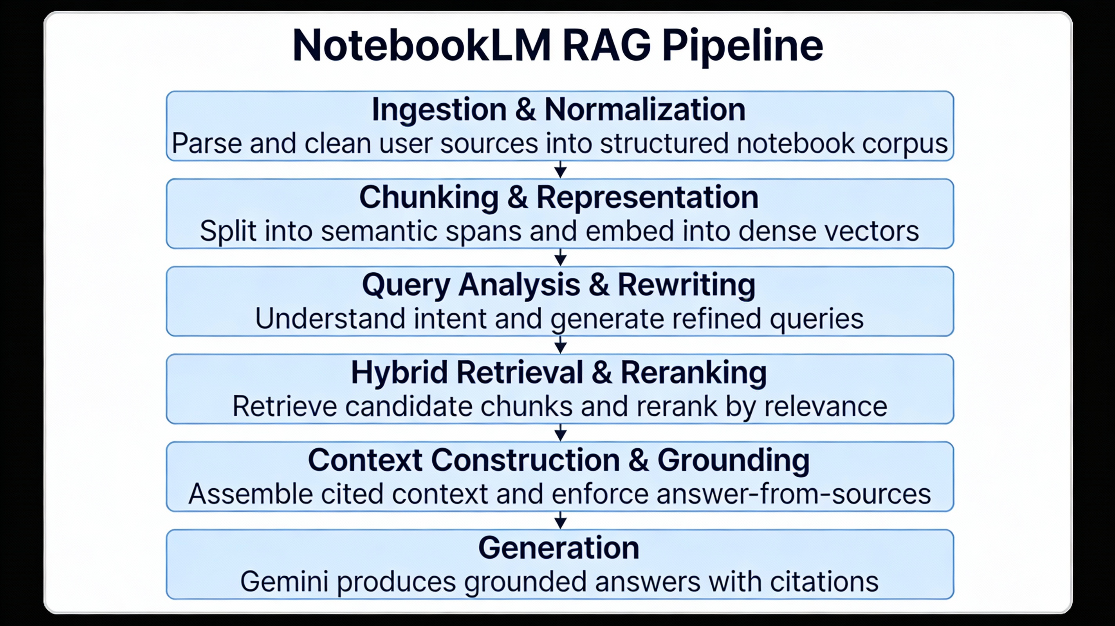
NotebookLM RAG Algorithm
1. Ingestion & Normalization
User-provided sources (PDFs, Docs, Slides, Web pages, transcripts) are parsed into structured text units (sections, headings, timestamps).
Content is cleaned, segmented, and annotated to form a per-notebook corpus.
2. Chunking & Representation
Documents are chunked into semantically coherent spans rather than fixed windows.
Each chunk is embedded using dense encoders and stored with metadata in a vector index.
3. Query Analysis & Rewriting
The user query is analyzed to infer intent and scope.
One or more rewritten queries are generated to improve retrieval coverage.

Slide 21
4. Hybrid Retrieval & Reranking
Dense vector retrieval retrieves candidate chunks.
Lexical and metadata filters refine results.
A reranking step reorders top candidates based on semantic relevance.
5. Context Construction & Grounding
Retrieved spans are assembled into a grounded context with explicit source references.
The model is instructed to answer strictly from provided sources.
6. Generation
Gemini generates responses grounded in retrieved content with inline citations.

Slide 22
Limitations of NotebookLM and Motivation for Agentic RAG
Current Limitations of NotebookLM
Static retrieval pipeline: Query formulation and retrieval strategy are fixed per user request, with no iterative refinement.
Limited decision-making control: Users cannot dynamically select retrieval tools, filters, or external knowledge sources.
Single-pass retrieval: Retrieval and reranking occur once, limiting performance on multi-step or exploratory queries.
Implicit reasoning: Reasoning is embedded within generation, without explicit planning or intermediate verification steps.
Motivation for Agentic RAG
Enables iterative query refinement based on intermediate retrieval results.
Allows dynamic tool and retriever selection for different information needs.
Supports multi-step reasoning across multiple retrieval cycles.
Improves handling of complex, compositional, and exploratory tasks.

Slide 23
Beyond Standard RAG: Agentic RAG
Conceptual Difference
Standard RAG: Single-shot retrieve → generate pipeline with no explicit planning or verification
Agentic RAG: Planner–retriever–tool–critic loop where agents decide what to retrieve, when to retrieve, and how to verify
Performance Outcomes
Improves factual accuracy and grounding through iterative retrieval and self-critique
Achieves higher task completion on complex, multi-step queries (e.g., policy reasoning, troubleshooting)
Evaluation Signals
Standard RAG: Recall@K, nDCG, EM, faithfulness metrics
Agentic RAG: End-to-end task success, error reduction, human-aligned or LLM-as-judge evaluation
Trade-offs
Higher latency and cost due to multiple retrieval and reasoning loops
Increased engineering and orchestration complexity

Slide 24
Conclusion
This thesis analyzed multiple Retrieval-Augmented Generation (RAG) frameworks to understand how retrieval affects reasoning and factual grounding in LLMs.
A comparative study across six key papers showed that while RAG improves factual accuracy, challenges remain in context fusion and multi-hop reasoning.
Beyond theory, an empirical two-stage retrieval pipeline (dense + CrossEncoder reranking) was implemented and evaluated on 100 CoQA questions, improving Hit@1 from 0.27 to 0.36 and EM@1 from 0.25 to 0.31.
These results demonstrate that better retrieval integration alone can measurably boost answer quality, even without full graph-based RAG.
The research outlines how future RAG systems can combine such empirical designs with structured approaches like Graph RAG to achieve more context-aware, reliable, and interpretable LLM applications.

Slide 25
Thank you
Questions? Suggestions? Looking forward to your feedback!

